Slide 1
ZOMATO - EXPLORATORY DATA ANALYSIS USING PYTHON

Slide 2
About Zomato
Launched in 2008, Zomato, a leading food delivery platform, boasts a valuation of ₹1 trillion.
Originally known as Foodiebay, it began as a restaurant recommendation service, reaching a peak of 35,000 menus and ₹60 lakh in monthly revenue.
Beyond its core online food delivery service, Zomato operates a range of supplementary ventures - app listings for restaurants, table reservation capabilities, advertising solutions and point-of-sale systems.
While online delivery is the primary revenue driver, it also incurs the most significant operational costs. The given dataset provides a glimpse into Zomato's restaurant data, offering valuable insights into potential areas of exploration.

Slide 3
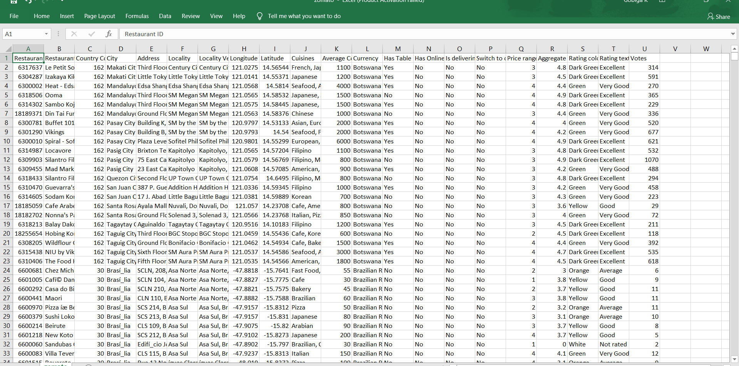
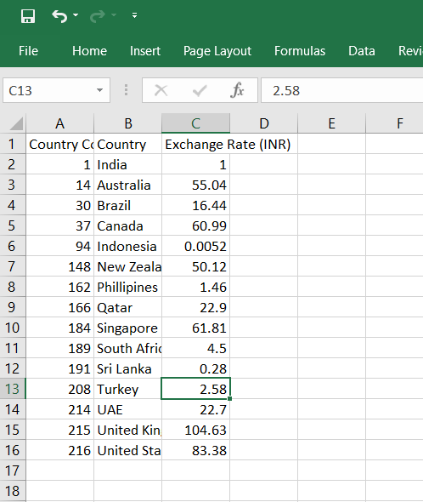
Given dataset

Slide 4
Observations
Online Delivery and Table Booking:
While online delivery is a popular option on Zomato, with many restaurants offering it, the same cannot be said for table booking.
Currently, a significant portion of restaurants lack both online delivery and table booking functionalities.
Only a small number offer both features.
This suggests that table booking on Zomato has room for significant growth.
2) Top Countries and Cities:
Most of the revenue generated by Zomato is in India with more than 8000 restaurants in India having Zomato as their delivery partner.
New Delhi is the highest contributor within India.
Gurgaon and Noida being almost similar in terms of food ordered occupy 2nd and 3rd position respectively.
These cities can also be termed as top 4 cities in India contributing to orders on Zomato.

Slide 5
Observations
3) Customer preferences:
North Indian cuisine is the most popular choice among Zomato users, followed by a variety of regional and international flavors.
Barbeque Nation consistently top the charts, indicating their widespread popularity.
4) Price range
Most restaurants fall within average rating category, with fewer options catering to budget-conscious or premium diners.
Super-luxury options exceeding $200,000 cater to a niche market and are relatively uncommon.
5) Rating distribution
Ratings on Zomato are a mixed bag, ranging from low to high with a significant portion falling in the average category.
The distribution of ratings actually varies across different countries. This suggests cultural preferences and dining expectations might influence how people rate restaurants.

Slide 6
Thank you..!!

